Slide 1





Slide 2
FUNCTIONS
A function is a block of organized, reusable code that is used to perform a single, related action.
Functions provide better modularity for the applications.
Functions provide a high degree of code reusing.

Slide 3
RULES FOR DEFINING FUNCTION IN PYTHON
Function blocks begin with the keyword def followed by the function name and
parentheses ( ( ) ).
Any input parameters or arguments should be placed within these parentheses. We also define parameters inside these parentheses.
The code block within every function starts with a colon (:) and is indented.
The statement return [expression] exits a function, optionally passing back an
expression to the caller.
A return statement with no arguments is the same as return None.

Slide 4
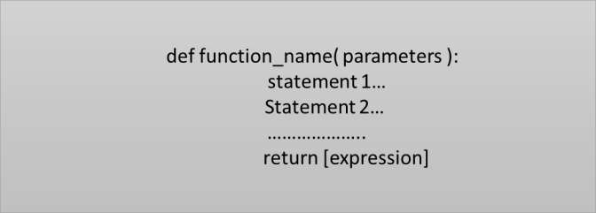
Function Syntax
Input Parameter is placed within the parenthesis() and also define parameter inside the parenthesis.
The keyword def introduces a function definition.
The code block within every function starts with a colon(:) .
Return statement exits a function block. And we can also use return with no argument.

Slide 5
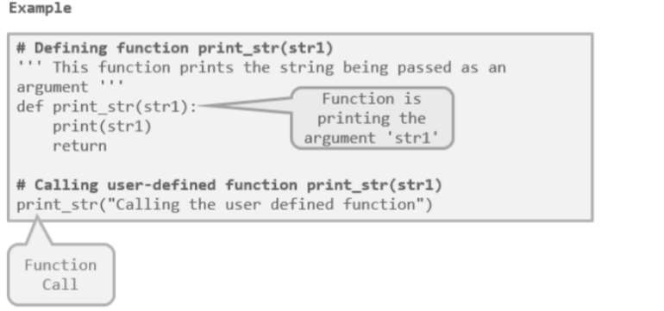

Slide 6
PASSING ARGUMENTS TO FUNCTIONS
In programming, there are two ways in which arguments can be passed to functions :-
Pass by Value:
Function creates a copy of the variable(Object in Python) passed to it as an argument.
The actual object is not affected.
Object is of immutable type,because immutable objects cannot be modiﬁed.
Pass by Reference:
The actual object is passed to the called function.
All the changes made to the object inside the function affect its original value.
Object is mutable type, as mutable objects can be changed, the passed objects are updated.

Slide 7
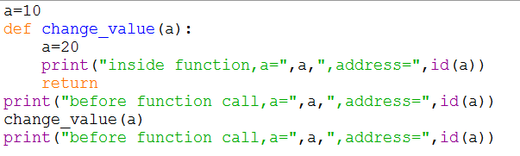




EXAMPLES OF PASSING IMMUTABLE ARGUMENTS
New memory address of ‘a’
inside the function.
OUTPUT:
Actual variable ‘a’ is not changed.

Slide 8
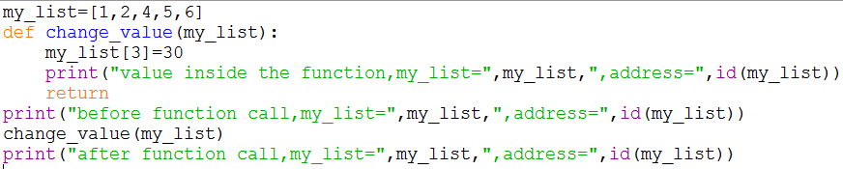





EXAMPLES OF PASSING MUTABLE ARGUMENTS
Value of my_list is changed after function call.
Address is same

Slide 9
FUNCTION ARGUMENTS

Slide 10
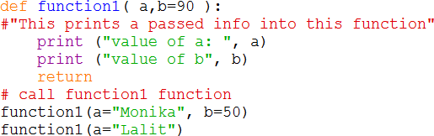

DEFAULT ARGUMENT VALUES
Default Argument- argument that assumes a default value if a value is not provided in the function call for that argument.
The default value is evaluated only once.
EXAMPLE:
In this code, argument ‘b’ has given a default value. ie(b=90)
Output:
When the value of ‘b’ is not passed in function ,then it takes default argument.

Slide 11
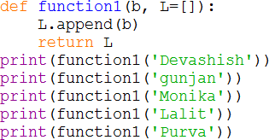
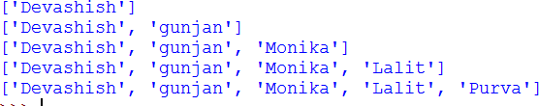
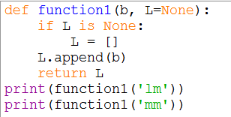

DEFAULT ARGUMENTS
The default value is evaluated only once. This makes a difference when the default is a mutable object such as a list, dictionary, or instances of most classes.
Example:
Output:
if we don’t want the default value to be shared between subsequent calls,
then
Example :
Output:

Slide 12
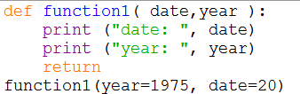

KEYWORD ARGUMENTS
Keyword arguments are related to the function calls.
Using keyword arguments in a function call, the caller identifies the arguments by the parameter name.
Allows to skip arguments or place them out of order, the Python interpreter use the keywords provided to match the values with parameters.
Example:
Caller identifies the keyword argument by the parameter name.
Calling of the argument Order
doesn’t matter .
Output:

Slide 13
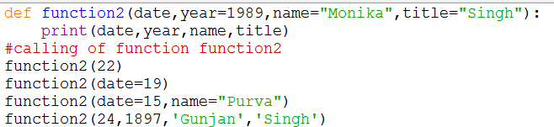

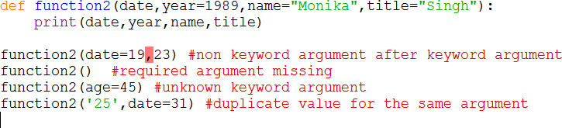
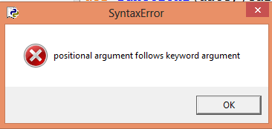
KEYWORD ARGUMENTS
Example 1:
Output:
Example 2:
Output:

Slide 14










ARBITRARY ARGUMENT LISTS
Variable-Length Arguments: more arguments than we specified while defining the function.
These arguments are also called variable-length arguments .
An asterisk (*) is placed before the variable name that holds the values of all non keyword variable arguments.
This tuple remains empty if no additional arguments are specified during the function call.
Syntax :
This is called arbitrary argument and asterisk sign is placed before the variable name.
def function_name([formal_args], *var_args_tuple ):
statement 1…… statement 2…… return [expression]

Slide 15
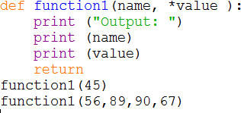
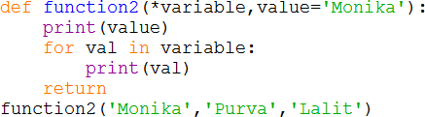








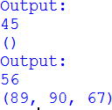















ARBITRARY ARGUMENT LISTS
EXAMPLE 1:
EXAMPLE 2:
Output:
Output:
Any formal parameter which occur after the *args parameter are keyword-only arguments.
If formal parameter are not keyword argument then error occurred.

Slide 16
















UNPACKING ARGUMENT LISTS
Arguments are already in a list or tuple, need to be unpacked for a function call requiring separate positional arguments.
For instance, the built-in range() function expects separate start and stop
arguments.
If range() are not available separately, write the function call with the *-operator
to unpack the arguments out of a list or tuple.
Example 1: Example 2:
In dictionary, we use ‘**’ for unpacking the
arguments
In tuples or lists, ‘*’ is used to unpack the arguments
Output:

Slide 17







LAMBDA EXPRESSIONS
Small functions can be created with the lambda keyword also known as
Anonymous function.
Used wherever functions object are required.
These functions are called anonymous because they are not declared in the
standard manner by using the def keyword. .
Syntax :
lambda [arg1 [,arg2,.....argn]]:expression
EXAMPLE:
The function returns the multiply of two arguments.
Lambda function is restricted to a single expressions.
Output:

Slide 18




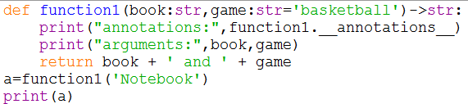



FUNCTION ANNOTATIONS
Function annotations are completely optional metadata information about the
types used by user-defined functions.
Annotations are stored in the “ annotations ” attribute .
Parameter annotations are defined by a colon after the parameter name,
followed by an expression evaluating to the value of the annotation.
Return annotations are defined by a literal ->, followed by an expression, between the parameter list and the colon denoting the end of the def statement.
Example:
Literal ‘->’ is used to define return annotations.
Output:

Slide 19


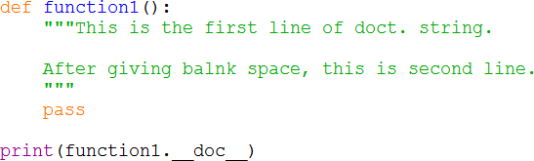


DOCUMENTATION STRINGS
The first line should always be a short, concise summary of the object’s purpose.
The first line should begin with a capital letter and end with a period.
If there are more lines in the documentation string, the second line should be
blank.
The first non-blank line after the first line of the string determines the amount
of indentation for the entire documentation string.
Example:
‘.doc’ is used to print the
documentation strings.
Output:

